Slide 1
14
Discrete Mathematics
Translating with Nested Quantifiers

Slide 2
















Slide 3


































Slide 4











Slide 5












































Slide 6



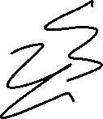









Slide 7











Slide 8
Up Next…
Rules of Inference for Propositional Logic

